Slide 1
PASSWORD STRENGTH
CLASSIFICATION
BY: RAY THIBODEAUX
& ABIOLA ADEGBOYEGA

Slide 2
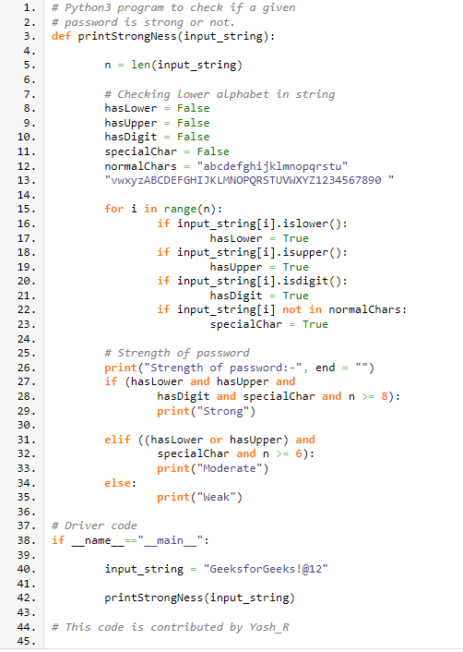

The Problem
Password Strength Classification
Improve password strength classification
Normal password meters - conditional
Machine learning strategy - mathematical model

Slide 3

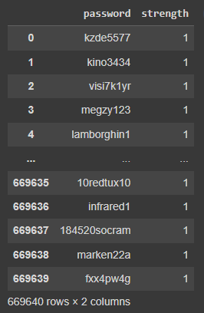
The Data

Slide 4
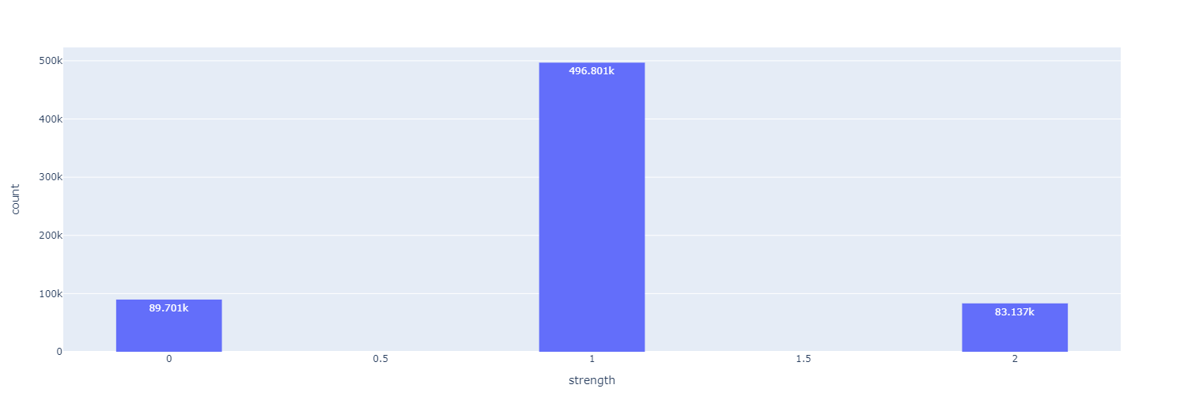
The Data
The Data

Slide 5





Data Cleaning

Slide 6
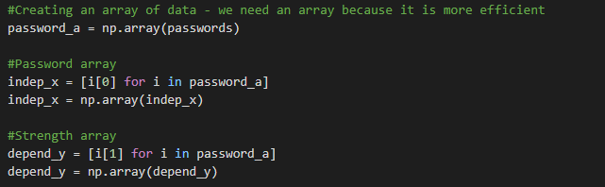
Data Pre-Processing - Tokenization
Tokenization - splitting each word into character so the computer can vectorize the data.
Create an array of data (passwords and strengths)

Slide 7
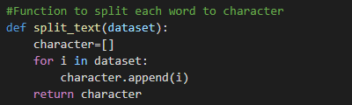
Data Pre-Processing - Tokenization
Tokenization - splitting each word into character so the computer can vectorize the data.
Create a function to split each password into characters

Slide 8


Data Pre-Processing - Tokenization
Tokenization - splitting each word into character so the computer can vectorize the data.
Pass the “split_text” function into the tokenizer so the method vectorizes characters and not the full password

Slide 9
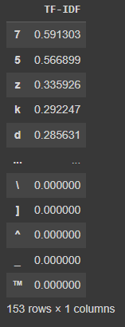
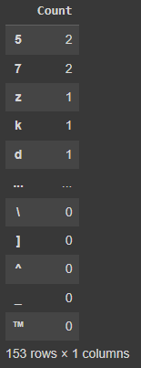
Data Pre-Processing - Password Vectorization
TF-IDF (Term Frequency Inverse Document Frequency)
Overall document weight
Count
Frequency compared to the index

Slide 10
Data Pre-Processing - Password Vectorization - Problems
Some vectorization models take advantage of the word meaning.
GloVe
FastText
Word2Vec

Slide 11
Data Pre-Processing - Side Note
Other methods of natural language processing aren’t used because we want the purest form of the passwords.
Removing special characters
Removing numbers
All lowercase text
Lemmatization - relating words to their root format. (ex. kept to keep)

Slide 12
Data Pre-Processing – Balancing Options
Oversampling – SMOTE, RandomOverSampling
Undersampling – ENN, RandomUnderSampling
Weighted Balancing

Slide 13
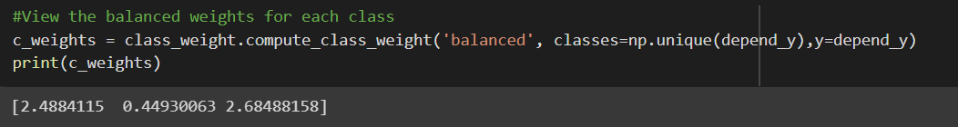
Data Pre-Processing – Balancing Option Chosen
Weighted Balancing

Slide 14
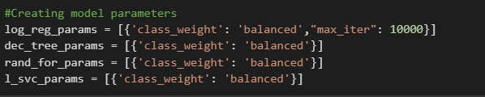
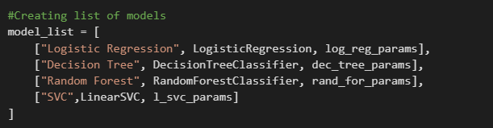
Data Pre-Processing - Split Data and Model Selection

Slide 15

Testing - Cross Validation

Slide 16
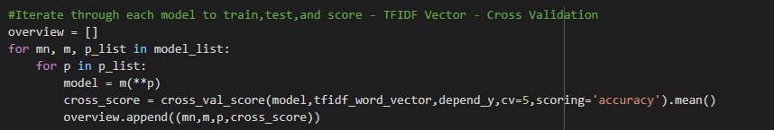
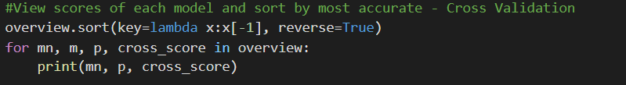


Testing - Cross Validation
Loop through each model and split the test data into 5 folds
Average the accuracy
Sort each model by accuracy
TFIDF Vector Results - CV
Count Vector Results - CV

Slide 17


Testing -Interactive Password Classification
Picking a model for real time classification
Random forest had the highest accuracy for the TF-IDF vector
Logistic Regression had the highest accuracy for the Count vector
TFIDF Vector Results - CV
Count Vector Results - CV

Slide 18
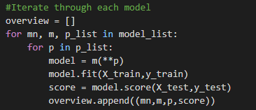
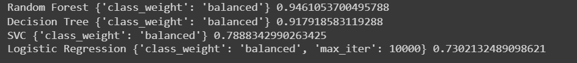


Learning and Testing - Balance, Fit, Train, and Test Models
Loop through each model in the model list to fit the data and test the data
Store values in a list “overview”
Sort the results
Output results by accuracy
TFIDF Vector Results
Count Vector Results

Slide 19
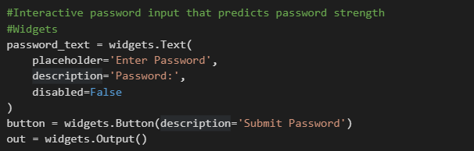
Testing -Interactive Password Classification
Widgets
Password input widget
Submit button widget
Clear output method

Slide 20
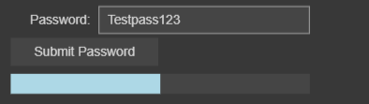
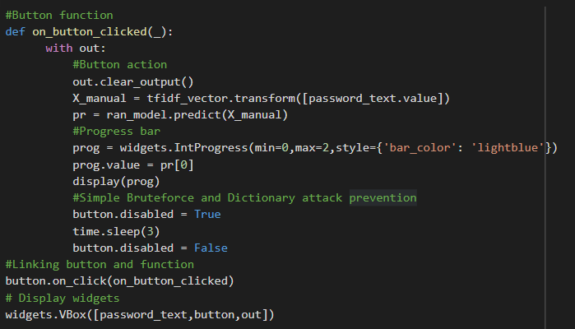
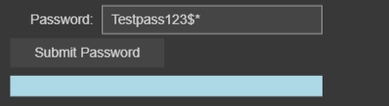
Testing -Interactive Password Classification
On submit Function
On button click clear output
Predict input class
Disable input for 3 seconds

Slide 21
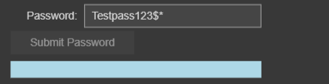

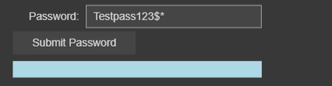
Testing -Interactive Password Classification
Password attack mitigation
On click disable submit button for 3 seconds
After 3 seconds enable submit button

Slide 22
Data Pre-Processing - Hyperparameter Tuning
Grid Search - looks for all possible combinations of parameters
Count Vector - Logistic Regression -
class_weight: ‘balanced’ to balance the data based on class weight
penalty: ‘L1’ Lasso regularization to avoid overfitting the data.
Lasso is better for lower featured datasets
Solver: ‘saga’: is a method used to optimize logistic regression. This method uses a smaller number of data points and is best for larger datasets.
TF-IDF Vector - Random Forest -
class_weight: ‘balanced’ to balance the data based on class weight
n_estimators: doubled the number of trees, the default is 100
Criterion: ‘entropy’ determines how the forest will split the data. The default is gini.

Slide 23
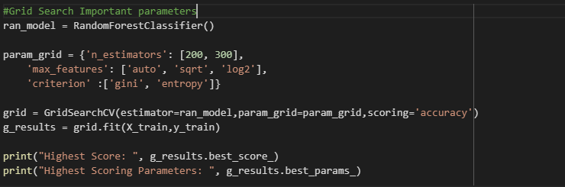
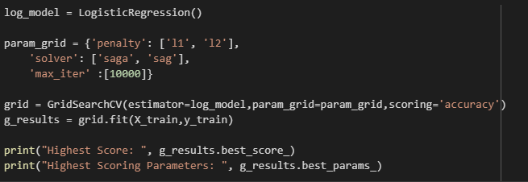

Tuning - Hyperparameter Tuning

Slide 24
Sources:
https://medium.com/analytics-vidhya/data-science-for-cybersecurity-password-strength-meter-b933b96bff32
https://towardsdatascience.com/nlp-text-preprocessing-a-practical-guide-and-template-d80874676e79
https://www.section.io/engineering-education/building-a-password-strength-classifier-model-using-machine-learning/
https://thecleverprogrammer.com/2022/08/22/password-strength-checker-with-machine-learning/
https://scikit-learn.org/stable/index.html
https://ipywidgets.readthedocs.io/en/stable/index.html
https://www.geeksforgeeks.org/program-check-strength-password/
https://medium.com/towards-data-science/stop-using-smote-to-treat-class-imbalance-take-this-intuitive-approach-instead-9cb822b8dc45
https://medium.com/analytics-vidhya/balance-your-data-using-smote-98e4d79fcddb
https://towardsdatascience.com/nlp-text-preprocessing-a-practical-guide-and-template-d80874676e79
https://medium.com/@technologger/how-to-interact-with-jupyter-33a98686f24e
https://towardsdatascience.com/how-i-handled-imbalanced-text-data-ba9b757ab1d8
https://medium.com/dataman-in-ai/sampling-techniques-for-extremely-imbalanced-data-part-i-under-sampling-a8dbc3d8d6d8
https://medium.com/codex/do-i-need-to-tune-logistic-regression-hyperparameters-1cb2b81fca69
https://medium.com/p/17aee785ee0d
https://medium.com/towards-data-science/hyperparameter-tuning-c5619e7e6624

